Slide 1
PYTHON : PROGRAMMING LANGUAGE FOR FUTURE!
Premanand S
School of Electronics Engineering (SENSE)
Vellore Institute of Engineering, Chennai campus

Slide 2
PYTHON – WHILE LOOP

Slide 3
Repeated Steps
n = 5
Program:
n = 5
while n > 0 :
print(n)
n = n – 1
print('Blastoff!')
print(n)
Output:
5
4
3
2
1
Blastoff!
0
No
n > 0 ?
Yes
print(n)
n = n -1
Loops (repeated steps) have iteration variables that change each time through a loop. Often these iteration variables go through a sequence of numbers.
print('Blastoff')

Slide 4
An Infinite Loop
n = 5
No
n > 0 ?
Yes
n = 5
while n > 0 :
print('Lather')
print('Rinse')
print('Dry off!')
print('Lather')
print('Rinse')
print('Dry off!')
What is wrong with this loop?

Slide 5
Another Loop
n = 0
No
n > 0 ?
Yes
n = 0
while n > 0 :
print('Lather')
print('Rinse')
print('Dry off!')
print('Lather')
print('Rinse')
print('Dry off!')
What is this loop doing?

Slide 6
Breaking Out of a Loop
The break statement ends the current loop and jumps to the statement immediately following the loop
It is like a loop test that can happen anywhere in the body of the loop
while True:
line = input('> ')
if line == 'done' :
break
print(line)
print('Done!')
> hello there
hello there
> finished
finished
> done
Done!

Slide 7
Breaking Out of a Loop
The break statement ends the current loop and jumps to the statement immediately following the loop
It is like a loop test that can happen anywhere in the body of the loop
while True:
line = input('> ')
if line == 'done' :
break
print(line)
print('Done!')
> hello there
hello there
> finished
finished
> done
Done!

Slide 8

No
True ?
Yes
while True:
line = input('> ')
if line == 'done' :
break
print(line)
print('Done!')
....
break
...
http://en.wikipedia.org/wiki/Transporter_(Star_Trek)
print('Done')

Slide 9
Finishing an Iteration with continue
The continue statement ends the current iteration and jumps to the top of the loop and starts the next iteration
while True:
line = input('> ')
if line[0] == '#' :
continue
if line == 'done' :
break
print(line)
print('Done!')
> hello there
hello there
> # don't print this
> print this!
print this!
> done
Done!

Slide 10
Finishing an Iteration with continue
The continue statement ends the current iteration and jumps to the top of the loop and starts the next iteration
while True:
line = input('> ')
if line[0] == '#' :
continue
if line == 'done' :
break
print(line)
print('Done!')
> hello there
hello there
> # don't print this
> print this!
print this!
> done
Done!

Slide 11
No
True ?
Yes
while True:
line = raw_input('> ')
if line[0] == '#' :
continue
if line == 'done' :
break
print(line)
print('Done!')
....
continue
...
print('Done')

Slide 12
Indefinite Loops
While loops are called “indefinite loops” because they keep going until a logical condition becomes False
The loops we have seen so far are pretty easy to examine to see if they will terminate or if they will be “infinite loops”
Sometimes it is a little harder to be sure if a loop will terminate

Slide 13
WHILE LOOP
Repeat a specific block of code
Used to iterate over a block of code as long as the test expression (condition) is true
While loop when we don't know the number of times to iterate beforehand
while test_expression:
Body of while

Slide 14
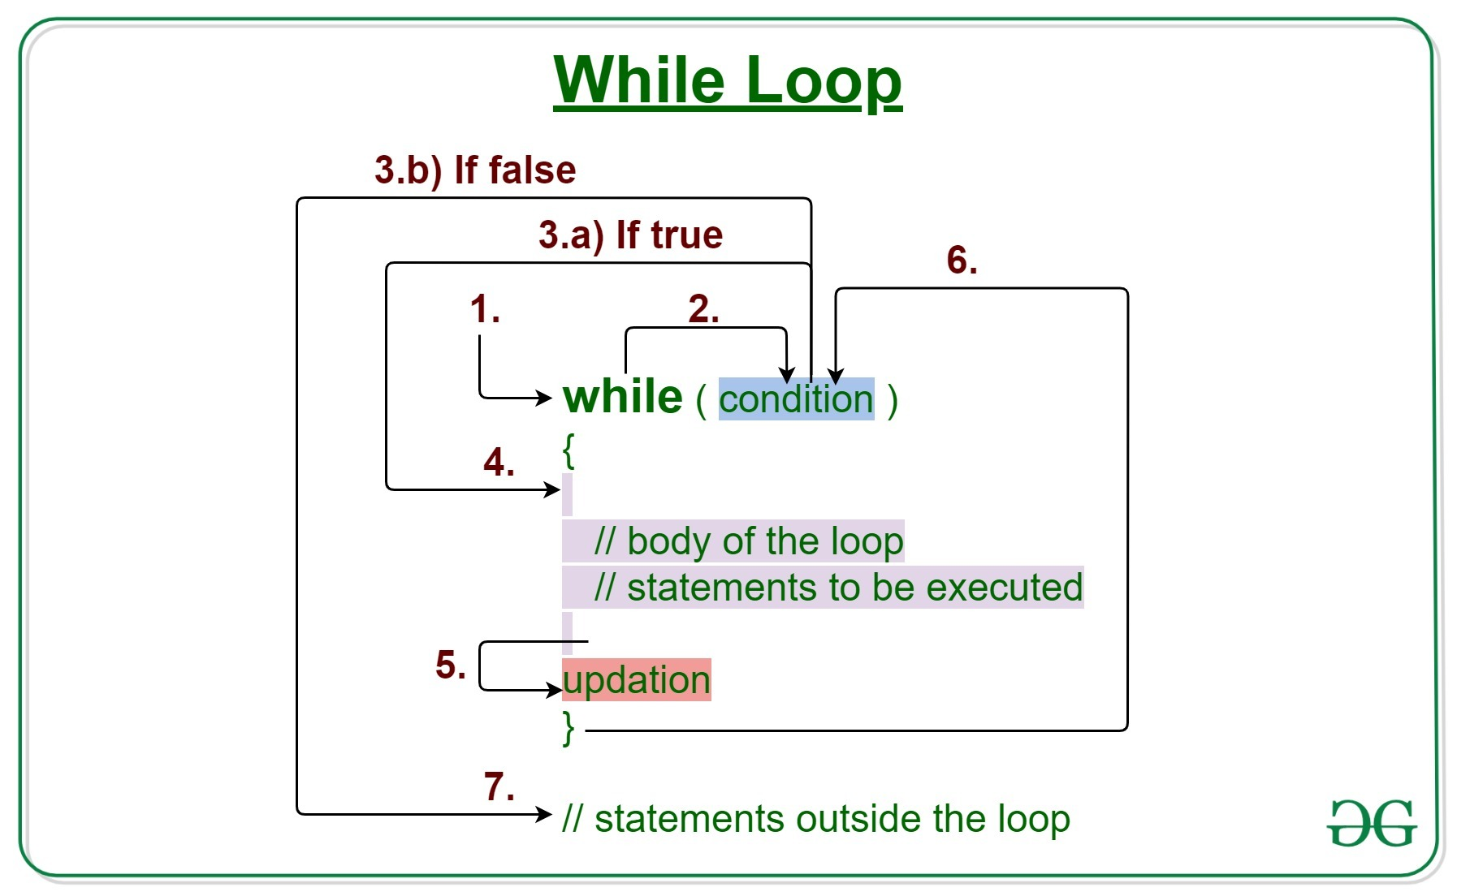
WHILE LOOP

Slide 15
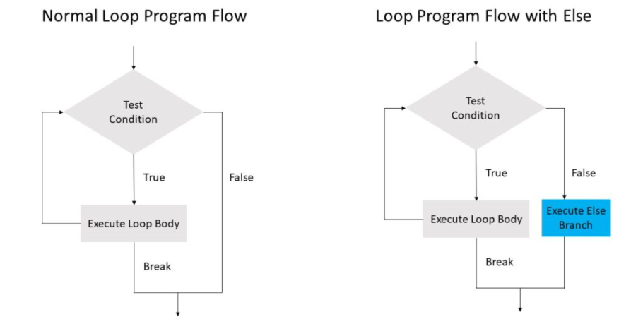
WHILE – ELSE

Slide 16
PYTHON – BREAK AND CONTINUE

Slide 17
BREAK & CONTINUE
To alter the flow of a loop
Loops iterate over a block of code until the test expression is false, but sometimes we wish to terminate the current iteration or even the whole loop without checking test expression
Break and continue

Slide 18
BREAK
terminates the loop containing it
Control of the program flows to the statement immediately after the body of the loop
If the break statement is inside a nested loop (loop inside another loop), the break statement will terminate the innermost loop
break

Slide 19
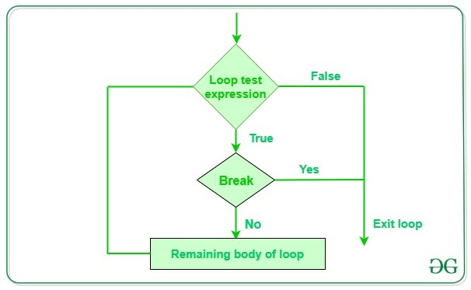
BREAK – WORK FLOW

Slide 20
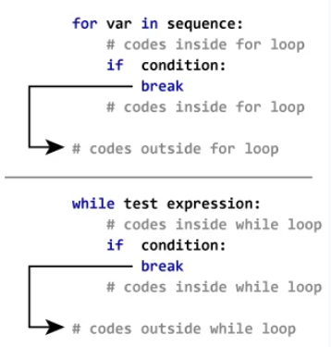
BREAK – FOR AND WHILE LOOPS

Slide 21
CONTINUE STATEMENT
The continue statement is used to skip the rest of the code inside a loop for the current iteration only.
Loop does not terminate but continues on with the next iteration
continue

Slide 22
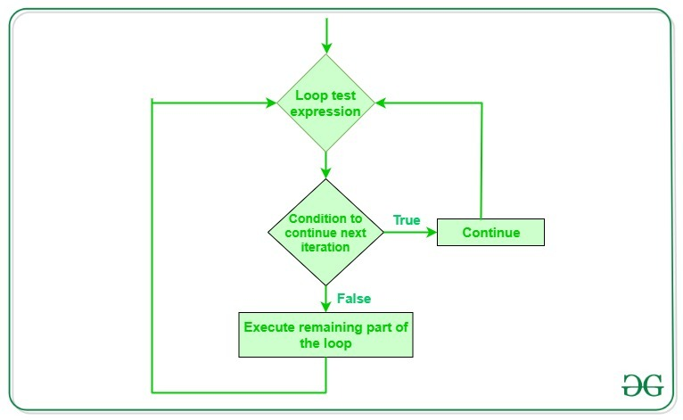
CONTINUE – WORK FLOW

Slide 23
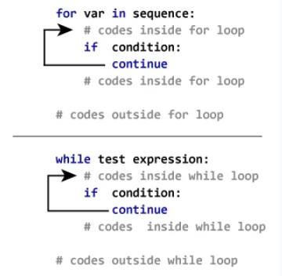
CONTINUE STATEMENT FOR FOR AND WHILE LOOP

Slide 24
PYTHON – PASS STATEMENT

Slide 25
PASS STATEMENT
Null statement
Difference with comment – not ignored and it’s no operation
Placeholder – future presprective
pass

Slide 26
HAPPY LEARNING & HAPPY CODING!
WhatsApp +91 7358679961
Official: premanand.s@vit.ac.in
Personal: er.anandprem@gmail.com
Weblink: www.anandsdata.com
Github: https://github.com/anandprems
Linkedin: https://www.linkedin.com/in/premsanand/
Author @ Analytics Vidya: https://www.analyticsvidhya.com/blog/author/premanand17/

